Slide 1
International Investing Dynamics
J.P. Morgan Investment Academy Series
Notes:
Hello, and welcome to another presentation in our Investment Academy series. I’m [NAME/TITLE] and our presentation today focuses on international investing — with an emphasis on the world’s equity markets — and how U.S. investors can make the most of the opportunities they represent.
It seems as though globalization has become somewhat of a cliché in our time. Yet some would argue that the global economy emerged with the Ottoman Empire which gave rise to expanded trade between Europe and Asia. The era unleashed the maritime empire-building powers of Portuguese, Spanish and Dutch explorers, well before the U.S. was even considered a frontier market.
Today’s broader, deeper and faster worldwide interconnectedness marks a dramatic shift in the cultural, financial and political links of our global economy. People are more connected than ever before. So are businesses and investors. From the foods we eat and the cars we drive, to the music we listen to and the news we consume. In many ways, the world is shrinking.

Slide 2
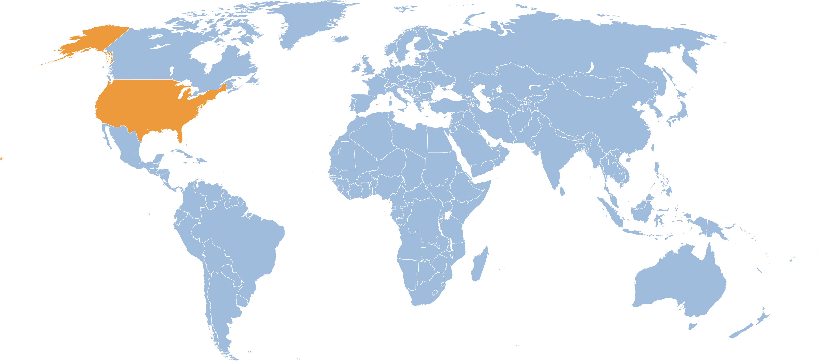
International investing dynamics
Domestic investing U.S. only
Global investing U.S. and Foreign
International investing Foreign only
■ | U.S.
■ | Foreign
Notes:
To level set our discussion, let’s start by clarifying a few terms.
When we talk about domestic investing, we’re talking strictly about companies and issuers domiciled in the U.S. Of course many companies distribute their products overseas – and some derive a significant share of their income from foreign markets, but in the context of investing these would be domestic entities.
Global investing includes U.S.-domiciled companies or governments, as well as foreign ones.
International investing, the focus of today’s conversation, excludes U.S. based securities.

Slide 3
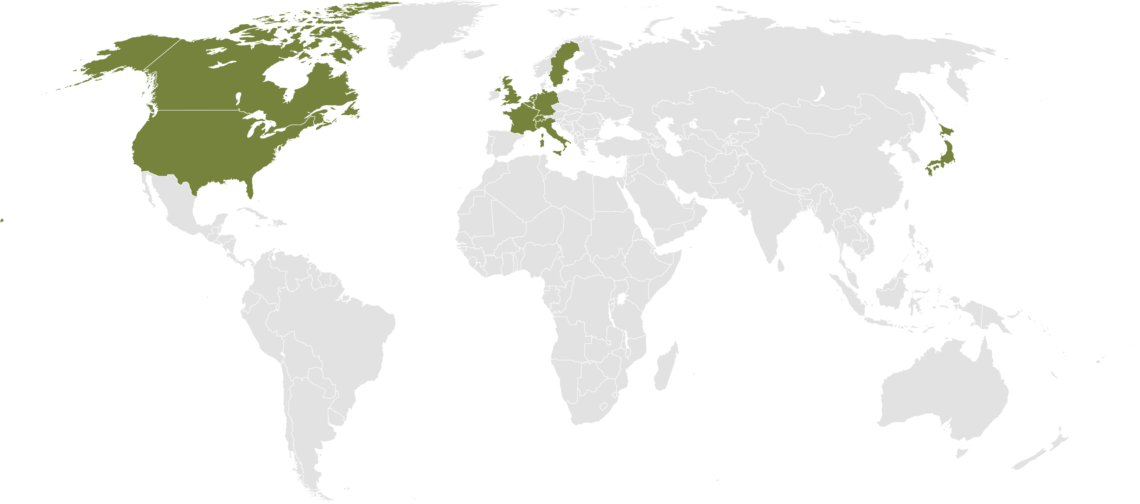
A world of opportunity
Developed markets
Germany
Sweden
Canada
Netherlands
United Kingdom
Belgium
United States
France
Japan
Switzerland
Italy
Notes:
When we talk about international investing, we also make a distinction between developed and emerging markets.
By “developed” markets, we typically mean the G10 countries – which are actually 11 industrialized nations, including Belgium, Canada, France, Germany, Italy, Japan, the Netherlands, Sweden, Switzerland, the United Kingdom and the United States.

Slide 4
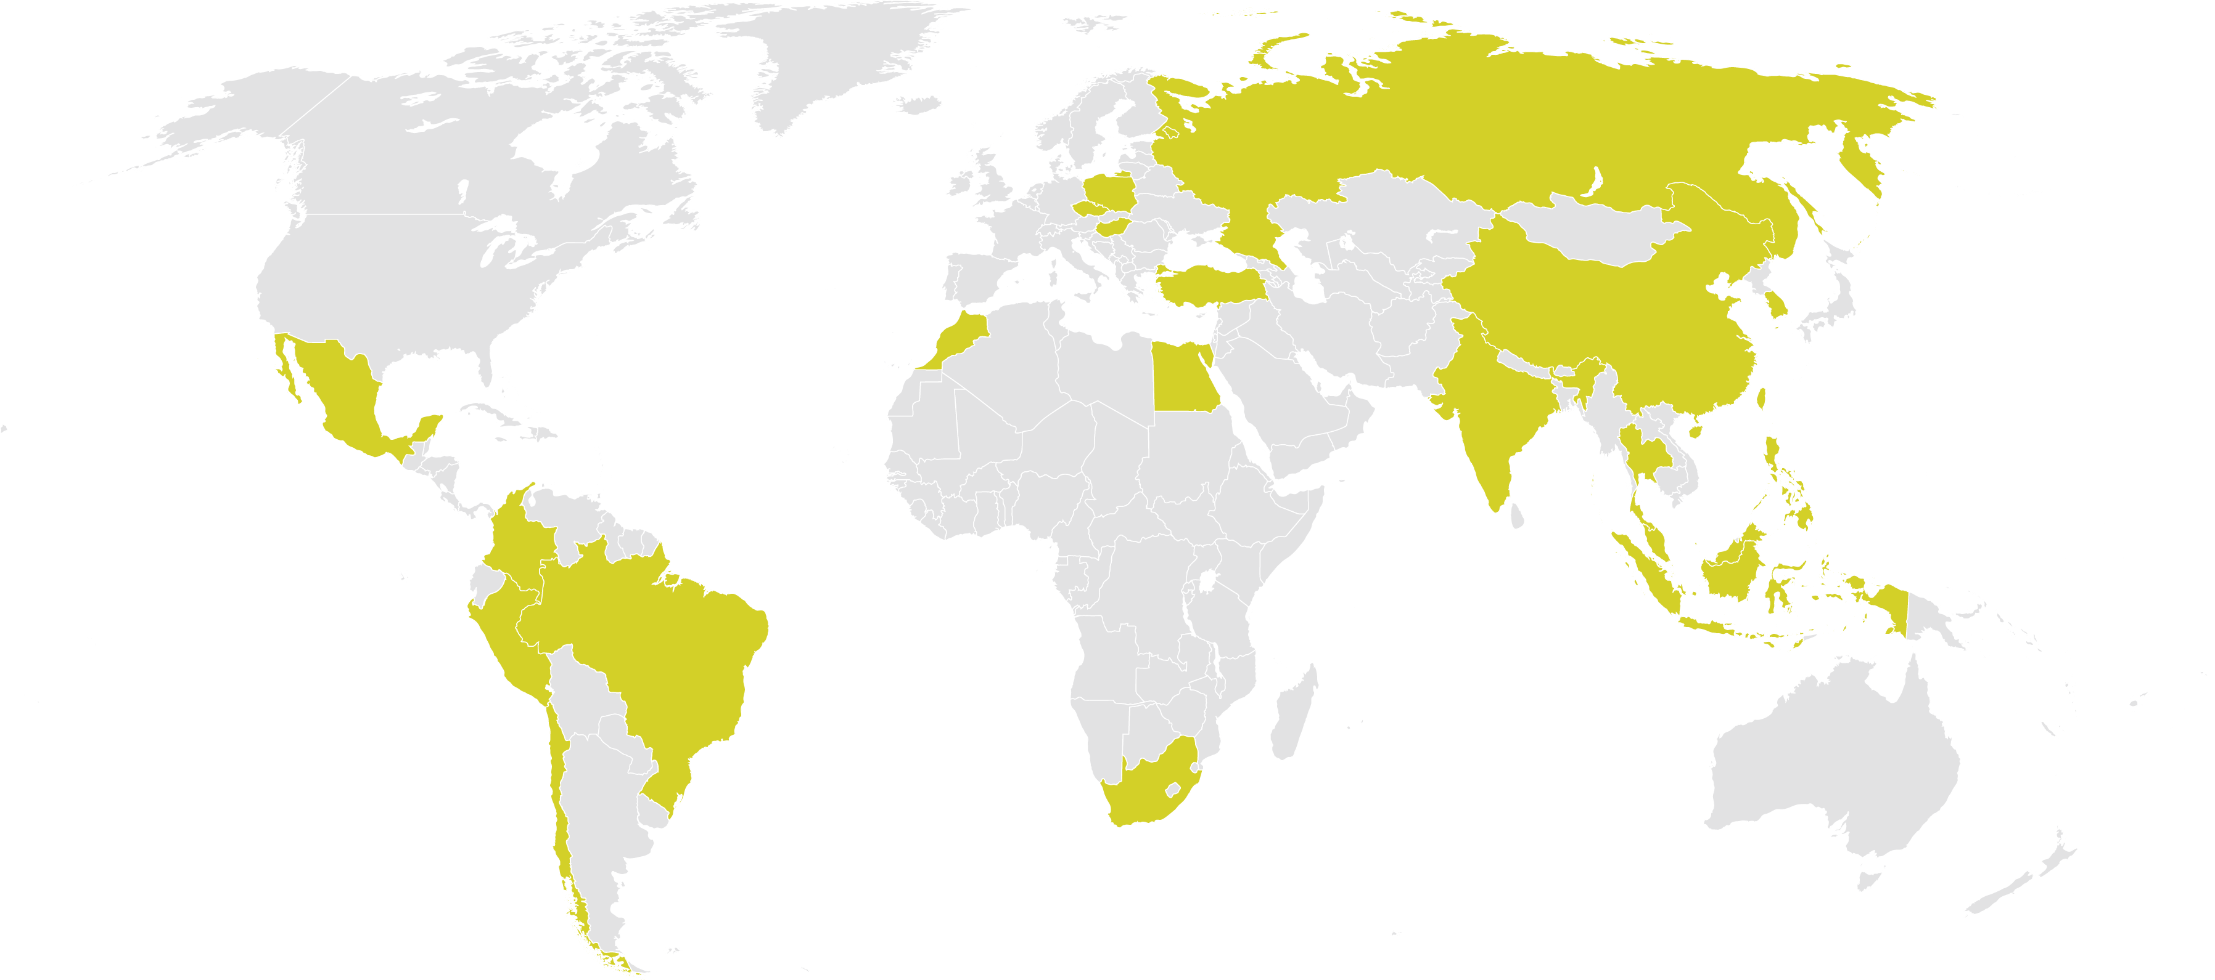
A world of opportunity
Emerging markets
Countries that comprise the MSCI Emerging Markets Index
Russia
Poland
Czech Republic
Hungary
Turkey
Morocco
China
Korea
Egypt
India
Taiwan
Mexico
Thailand
Philippines
Columbia
Malaysia
Peru
Brazil
Indonesia
Chile
South Africa
Notes:
The term “emerging” markets generally refers to growing markets that haven’t reached a mature stage of political or economic development.
As illustrated in this map, the MSCI Emerging Markets Index encompasses over 21 countries. The Emerging Markets equity universe spans large, mid and small cap securities and can be segmented across styles and sectors.

Slide 5
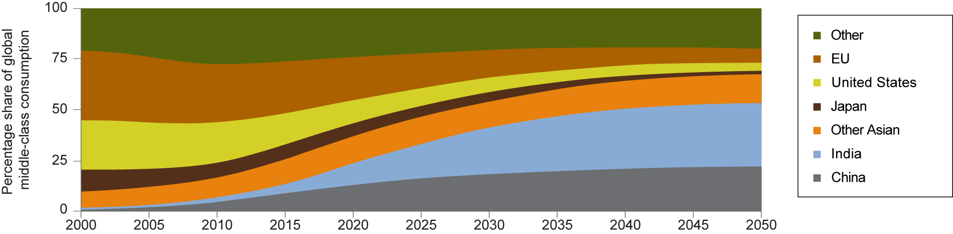
A world of shifting demographics and urbanization
Global middle-class wave shifting consumption East
Global middle-class consumption will shift heavily toward China, India and other Asian countries (excluding Japan) as the high-income countries see their share decrease.
Notes:
…and demand for products, services and natural resources is growing among “emerging markets” where global middle-class consumption is on the rise.
The market for companies selling to EM consumers is enormous; populations already exceed those in the developed world and are growing much faster. And EM countries are selling more raw materials and finished goods to one another.
A key factor impacting these emerging markets is urbanization — the continuing population shift from the countryside to cities — that influences both productivity and consumption. These migration patterns have led to a growing need for highways, housing, utilities, public transportation, water treatment and energy, most of which will be funded by government spending and private sector investment.

Slide 6
A world of shifting demographics and urbanization
Migration from rural to urban areas Top 25 hot spots by 2025 Cityscope 2025 city rankings
Rank | GDP² | Per capita GDP² | GDP growth² | Total population | Children³ | Total households | Households with annual income over $20,000⁴
1 | New York | Oslo | Shanghai | Tokyo | Kinshasa | Tokyo | Tokyo
2 | Tokyo | Doha | Beijing | Mumbai | Karachi | Shanghai | New York
3 | Shanghai | Bergen | New York | Shanghai | Dhaka | Beijing | London
4 | London | Macau | Tianjin | Beijing | Mumbai | São Paulo | Shanghai
5 | Beijing | Trondheim | Chongquing | Delhi | Kolkata | Chongqing | Beijing
6 | Los Angeles | Bridgeport | Shenzhen | Kolkata | Lagos | New York | Paris
7 | Paris | Hwasǒng | Guangzhou | Dhaka | Delhi | London | Rhein-Ruhr
8 | Chicago | Asan | Nanjing | São Paulo | Mexico City⁵ | Mumbai | Osaka
9 | Rhein-Ruhr | San Jose | Hangzhou | Mexico City⁵ | New York | Delhi | Moscow
10 | Shenzhen | Yosu | Chengdu | New York | Manila | Mexico City⁵ | Mexico City⁵
11 | Tianjin | Calgary | Wuhan | Chongqing | Tokyo | Rhein-Ruhr | Los Angeles
12 | Dallas | Al-Ayn | London | Karachi | Cairo | Paris | São Paulo
13 | Washington, D.C. | Edinburgh | Los Angeles | Kinshasa | Lahore | Kolkata | Seoul
14 | Houston | Charlotte | Foshan | London | São Paulo | Lagos | Chicago
15 | São Paulo | San Francisco | Taipei | Lagos | Kabul | Osaka | Milan
16 | Moscow | Durham | Delhi | Cairo | Buenos Aires | Dhaka | Mumbai
17 | Chongqing | Ulsan | Moscow | Manila | Luanda | Tianjin | Cairo
18 | Randstad | Washington, D.C. | Singapore | Shenzhen | London | Shenzhen | Hong Kong
19 | Guangzhou | Boston | São Paulo | Los Angeles | Los Angeles | Moscow | Taipei
20 | Mexico City⁵ | Belfast | Tokyo | Buenos Aires | Colombo | Chengdu | Randstad
21 | Osaka | New York | Shenyang | Rio de Janeiro | Baghdad | Cairo | Shenzhen
22 | Philadelphia | Grande Vitória | Xi'an | Tianjin | Shanghai | Rio de Janeiro | Istanbul
23 | Boston | Canberra | Dongguan | Paris | Paris | Wuhan | Delhi
24 | San Francisco | Seattle | Mumbai | Jakarta | Jakarta | Los Angeles | Buenos Aires
25 | Hong Kong | Zurich | Hong Kong | Istanbul | Istanbul | Buenos Aires | Madrid
■ | Developed regions¹
■ | Developing regions
NOTE: For metropolitan regions, we use the first name of the region (e.g., New York for New York–Newark). SOURCE: McKinsey Global Institute Cityscope 1.0
Notes:
As global populations become more urbanized, wages and living standards tend to rise, thereby increasing the consumption of both basic materials and luxury goods.
Growing populations and productivity gains in these markets are expected to continue to drive and support economic growth, which spells opportunity for both equity and fixed income investors.

Slide 7
Historic reasons to invest internationally: diversification and returns
Trailing 3-year correlations
December 31, 1981 – September 30, 2012
Historical performance in USD
As of September 30, 2012
Notes:
Historically two factors motivated Americans to invest outside the U.S.: diversification and the potential for greater returns.
Those of you that participated in our “correlation matters” discussion will recall that diversification benefits are achieved when the correlation of asset classes is negative — that is, when one zigs, the other zags. Correlation measures the relationship between the price movements of two securities or classes of securities in relation to one another.
That was the case prior to the late 1990s — but as markets became more globalized, they also responded more similarly to one another. The line chart on the left illustrates the correlation of U.S. markets, represented by the brown line; large foreign stock markets are depicted by the blue line; and emerging markets, that don’t appear until the late 1990s, are represented by the orange line. These relationships can shift over time, and during different economic cycles the relationships may exhibit different price behaviors. During periods of crisis, such as the sharp downturn in 2008 – 2009, many asset correlations rose.
Generally, though, international assets respond uniquely to market events. The fact that they don’t move in lock step with one another is precisely what makes them good diversifiers.
The bar chart on the right shows that different performance behavior historically was, and continues to be, a reason why U.S. investors diversify beyond domestic markets.

Slide 8
Greater opportunities outside the United States
While the U.S. economy is the largest, it represents only 19% of global GDP.
Share as a % of Global GDP
■ | EM
■ | United States
■ | Europe
■ | Japan
■ | Other developed
■ | United Kingdom
■ | Canada
Notes:
Why does investing outside the U.S. matter?
The obvious answer — illustrated by this colorful chart — is that an American investor would severely limit exposure to some of the world’s most dynamic opportunities. While the U.S. is the largest economy in the world, it only represents 19% of global gross domestic product, or GDP.
Those of you that recollect our Economic Indicators presentation will remember that GDP is an important measure of a country’s total economic power. It represents the value of all goods and services produced in a year and characterizes the rate at which a country’s economy is growing or contracting.
If the U.S. represents only 19% of GDP, that means that the rest of the world’s growth — 81% — originates outside the U.S.

Slide 9
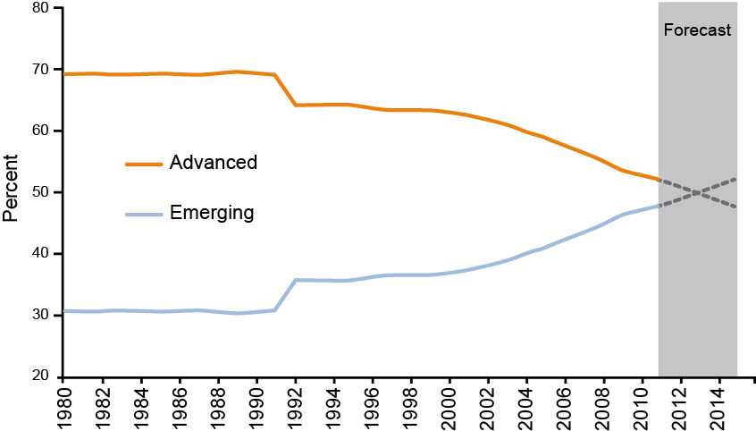
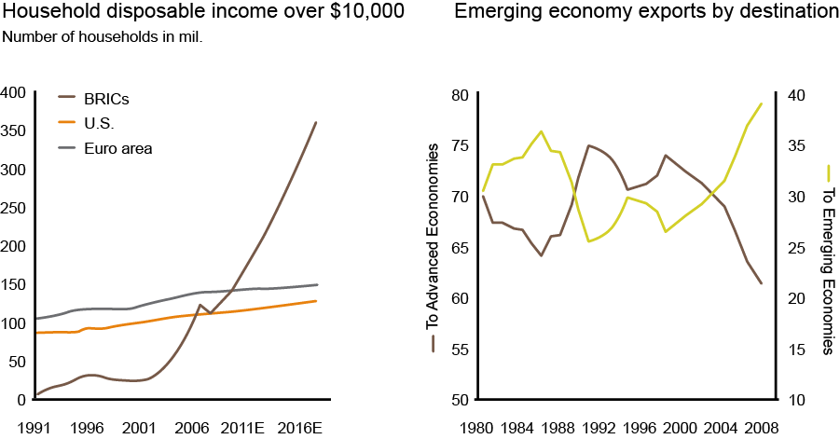
Rising influence of emerging markets
Emerging markets’ contribution to global GDP growth forecast to surpass developed markets by 2013*
A self-sustaining economic force**
Notes:
The fact is, the world has changed over the last 20 years.
Emerging market growth rates have outpaced developed markets by almost two-to-one over the past decade, and these economies appear poised to be major contributors to global economic growth in the coming years.
In terms of share of global GDP, the International Monetary Fund expects emerging markets to overtake developed economies by 2014, generating more than 70% of global growth over the next few years.
Since the initiation of economic reforms in the late 1970s, China has become one of the world’s fastest-growing economies.
India is another example of how consumption is changing the investment opportunities landscape. For example, with a population of 1.2 billion people, Indian consumers bought 2.2 million cars in 2010 — and 11 million motorcycles. Think about the fact that 400 million Indians have never used toothpaste even once; less than 10% use a hair conditioner; and only 5% of the population use deodorant.
Emerging markets encompass countries with diverse economic conditions and often very different cultural and political environments — all the more reason why investors should consider allocations to them within the context of a balanced portfolio.

Slide 10
A shifting investment landscape
U.S. equity footprint: largest equity market, but only 47% of global market cap*
81% of economic activity and 53% of market cap originate beyond the U.S.
The U.S. is also the largest fixed income market, representing 33% of global fixed income asset values
Two thirds of the debt markets’ opportunity resides outside the U.S.
MSCI ACWI country breakdown
■ | United States
■ | Europe
■ | EM
■ | United Kingdom
■ | Japan
■ | Other developed
■ | Canada
Korea 2%
Brazil 2%
Russia 1%
India 1%
China 2%
Other 5%
Notes:
This illustration shows show that, while the U.S. remains the largest equity market with a 47% share, more than two-thirds of the opportunities and 53% of market cap exist outside the U.S.
The same is true for the fixed income markets. The globalization of financial markets has led to the deepening of fixed income securities markets outside the U.S. The euro corporate bond market, for example, has doubled since the formation of the EMU in 1998. The structure and depth of global fixed income, encompassing the government, corporate and securitized product sectors, continues to evolve, facilitated by innovation and deregulation.
While the U.S. represents the largest share of global fixed income markets at 33%, greater opportunity exists in foreign markets. The sheer number of investment opportunities outside the U.S. — whether it’s stocks or bonds — is large… and growing.

Slide 11
A more interconnected world
Company | Total revenue (U.S. $ in billions) | Percent from overseas
Wal-Mart | 420 | 26%
Exxon-Mobil | 342 | 45%
General Electric | 149 | 54%
Bank of America | 134 | 20%
Ford | 129 | 51%
IBM | 100 | 64%
Boeing | 64 | 41%
Dow Chemical | 54 | 67%
Intel | 44 | 85%
McDonald's | 24 | 66%
Notes:
At the outset, I mentioned that many global companies generate a significant portion of their income outside their own countries.
To some extent, Americans who own U.S. company stocks that benefit from global trade have some international exposure. This table shows that the share of revenue growth for some U.S. companies originating outside the country is substantial. US News chief business correspondent Rick Newman recently observed that, “Illinois and Florida may not be the growth markets they once were for John Deere and Pizza Hut, but Brazil and China more than make up for it.”
But, over the long term, the argument for long-term investing in international companies remains a powerful one. But many investors still view foreign corporations in the context of their home markets. Investors remain under-exposed to foreign assets.
A home-country bias persists — regardless of where investors live, which conflicts with the tenets of broad global diversification.
Today, where a company has its headquarters very often has little to do with where it generates its earnings. Iconic, made-in-the-USA brands — like Budweiser, Firestone and Gerber — are now owned by foreign corporations. And familiar names in American households, like Sony, Nestle, Phillips, Bayer are all foreign-based companies that have flourished in the U.S.
From the standpoint of just about any investor, significant opportunities can be found outside their home country. Like many opportunities, growth follows the simple economics of supply and demand…

Slide 12
What does domicile really tell us?
Major European companies have diversified revenue sources.
Schneider Electric — French industrial cyclical company
Global manufacturer of electrical distribution and industrial engineering equipment
U.S. and European growth coming from industry, datacenter and energy efficiency initiatives
Increased focus on China while maintaining a strong presence in the U.S.
Above-average pricing power as customers are less concentrated
2011 revenue breakdown by region
■ | Developed Europe
■ | Asia
■ | North America
■ | Rest of the world*
Unilever — Anglo-Dutch consumer products company
Transformational managerial changes created a more entrepreneurial culture
Relatively buoyant growth in emerging markets should continue to drive the top-line with strong underlying volume growth and market share gains
Management is clearly focusing on consistent delivery of growth
2011 revenue breakdown by region
■ | Asia and Africa
■ | The Americas
■ | Europe
Notes:
Here are two examples of European companies — a French manufacturing company and a Dutch consumer products company — that have diversified their revenue sources beyond their own countries and region.
About a third of the revenues from industrial engineering equipment manufacturer Schneider Electric come from Europe — while the rest originates from other parts of the world.
Unilever, which markets well-known consumer brands like Ben & Jerry’s, Dove soap, Lipton Tea and Vaseline, distributes its products throughout the globe — with more than two-thirds of its income derived outside Europe.

Slide 13
Correlation between equity returns and GDP growth
No stable relationship between growth and equity returns regardless of time frame
Chinese equity returns have been lower and more volatile than those of the U.S. despite better growth
Data as of 12/31/10
Number of years for which data is available
GDP growth and equity performance: China vs. U.S. 1992 – 2010
Source: Investment Strategy Group, ABN-AMRO Global Investment Returns Yearbook 2005, data as of 2005, measuring correlation between equity returns of 17 country index consisting of Australia, Belgium, Canada, Denmark, France, Germany, Ireland, Italy, Japan, Netherlands, South Africa, Spain, Sweden, Switzerland, United Kingdom and the United States and their respective GDPs.
All figures are annualized.
*GDP Growth through 2009 since 1992.
**EPS Growth October 1995 – December 2010.
Source: Investment Strategy Group, IMF WEO October 2010, Datastream, MSCI.
Notes:
Research shows that just because a country’s economy is growing doesn’t necessarily mean that it’s a good investment.
The chart on the left shows that no significant relationship exists between growth and equity returns — regardless of the time frame.
And look at the comparison of China and the U.S. on the right. Despite better overall economic growth in China, U.S. equities have generated better returns with less volatility over the period from 1992 to 2010.
The point here is that research matters; whether it’s a stock or a bond, in the U.S., France or China, investors have to know what they’re buying. And frankly, access to some markets is limited.

Slide 14
Economic superiority not necessarily correlated with equity returns
Weaker economic performance in Europe and Japan does not necessarily fuel market or earnings performance versus the United States.
As of December 31, 2011
 | 2004 |  |  | 2005 |  |  | 2010 |  |  | 2011
 | GDP (%) | Earnings (%) | Market return (%) | GDP (%) | Earnings (%) | Market return (%) | GDP (%) | Earnings (%) | Market return (%) | GDP (%) | Earnings (%) | Market return (%)
U.S. | 6.4 | 18.1 | 10.9 | 6.5 | 14.7 | 4.9 | 4.2 | 33.7 | 15.1 | 3.9 | 12.6 | 2.1
Continental Europe | 3.9 | 26.1 | 21.6 | 3.8 | 19.8 | 10.5 | 4.2 | 42.5 | 1.6 | 3.3 | -9.5 | -15.3
Japan | 1.0 | 39.0 | 15.9 | 0.0 | 22.7 | 25.5 | 2.3 | 52.0 | 15.4 | -2.8 | -48.0 | -14.3
Notes:
Here’s another way of looking at the growth/investment returns link.
Economic superiority of a region does not necessarily translate to superior equity returns — as illustrated over several periods in the last 10 years.
Weak performance in Europe and Japan doesn’t necessarily mean that U.S. equity returns will be strong.
Europe, in 2004, had a slower growth rate, but had greater market returns than Japan and the U.S. In 2005 and 2010, Japan posted paltry GDP growth, but managed to outperform European and U.S. markets.

Slide 15
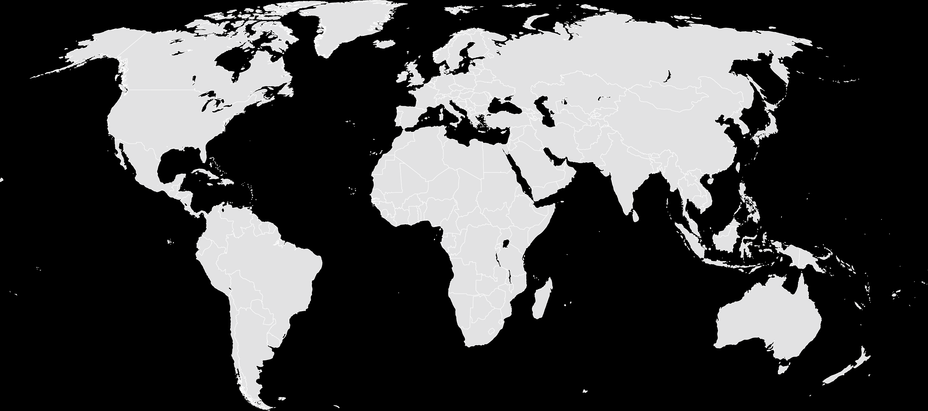
When is a good time to invest internationally — and where?
Notes:
So if we step back and look around the world, we might wonder …

Slide 16
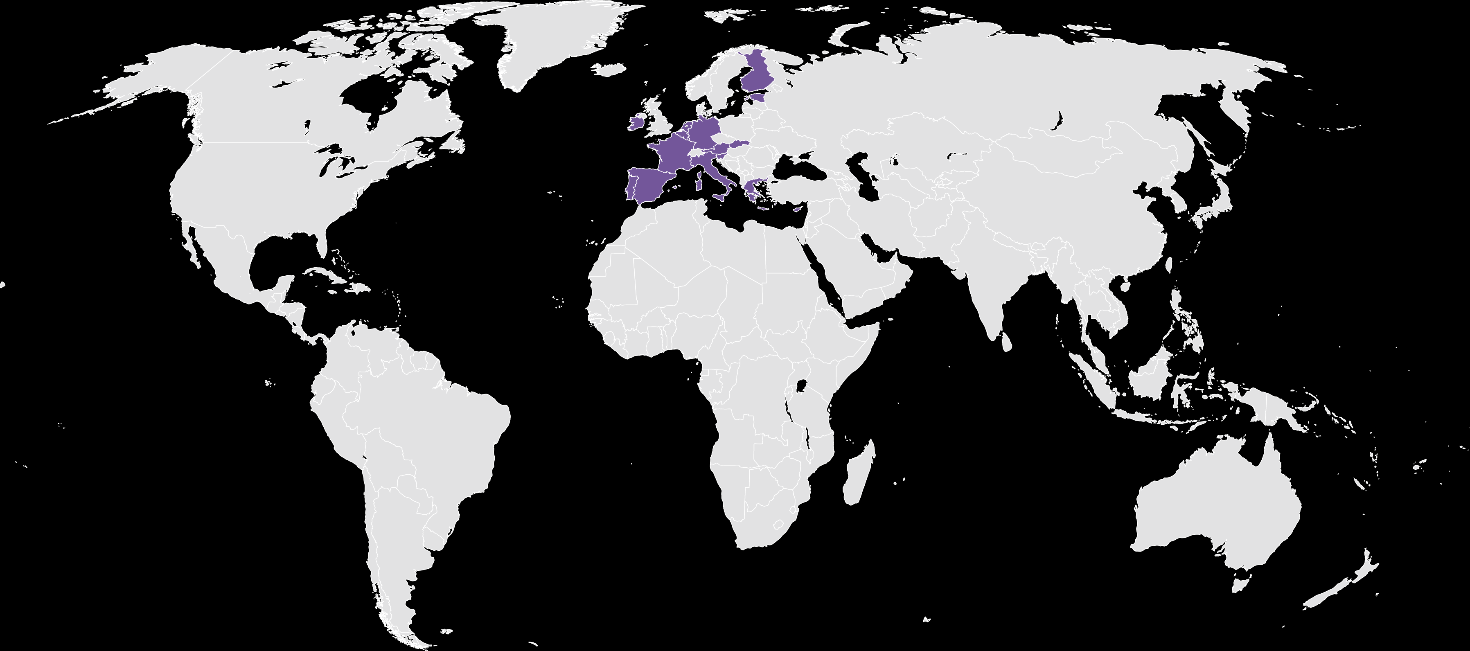
When is a good time to invest internationally — and where?
Eurozone?
Notes:
Who in their right mind would want to invest in Europe now with so much turmoil and an economy that appears to be teetering on collapse;

Slide 17
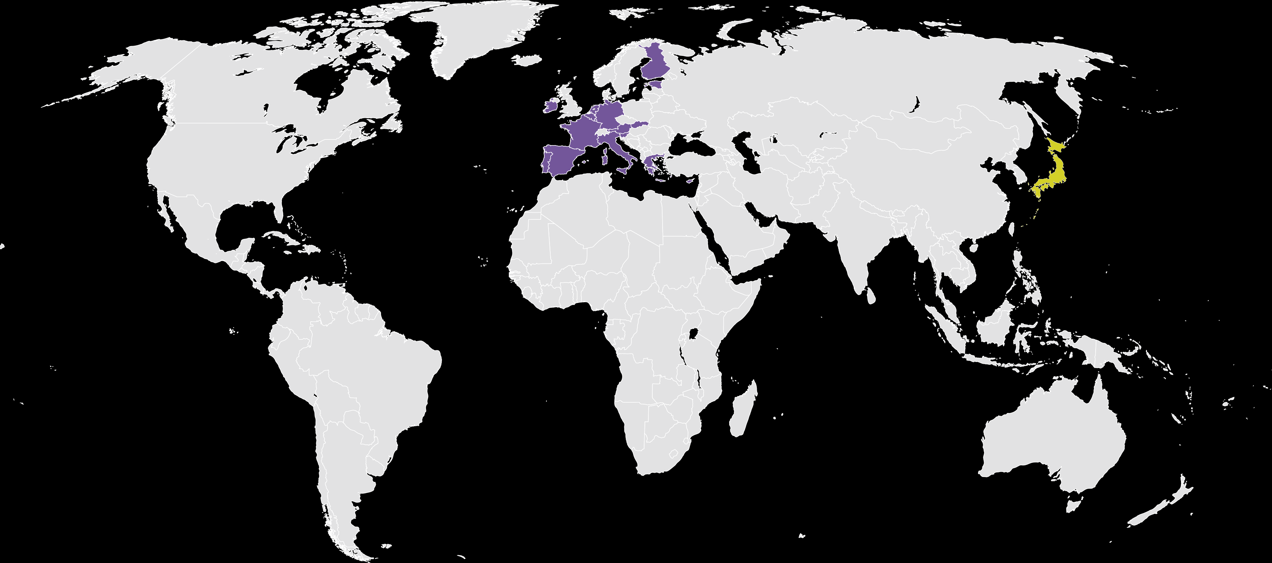
When is a good time to invest internationally — and where?
Eurozone?
Japan?
Notes:
And what about Japan? The world’s third largest economy – still recovering from a devastating earthquake in 2011 – not to mention a shrinking and aging population – has a gross debt to GDP of about 200%, the highest among developed nations and falling prices remain an entrenched phenomenon

Slide 18
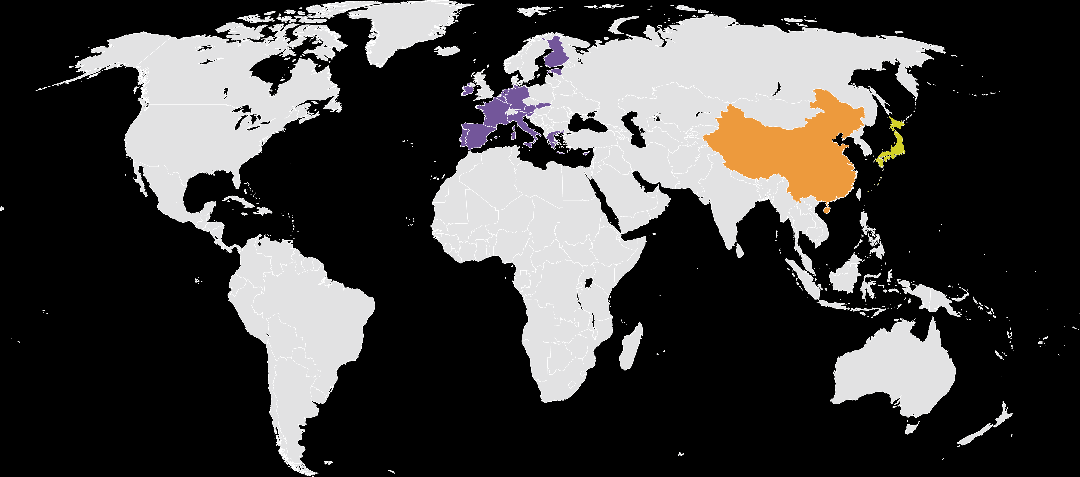
When is a good time to invest internationally — and where?
Eurozone?
Japan?
China?
Notes:
China’s slowdown and a new governing body could mean more disappointment ahead;

Slide 19
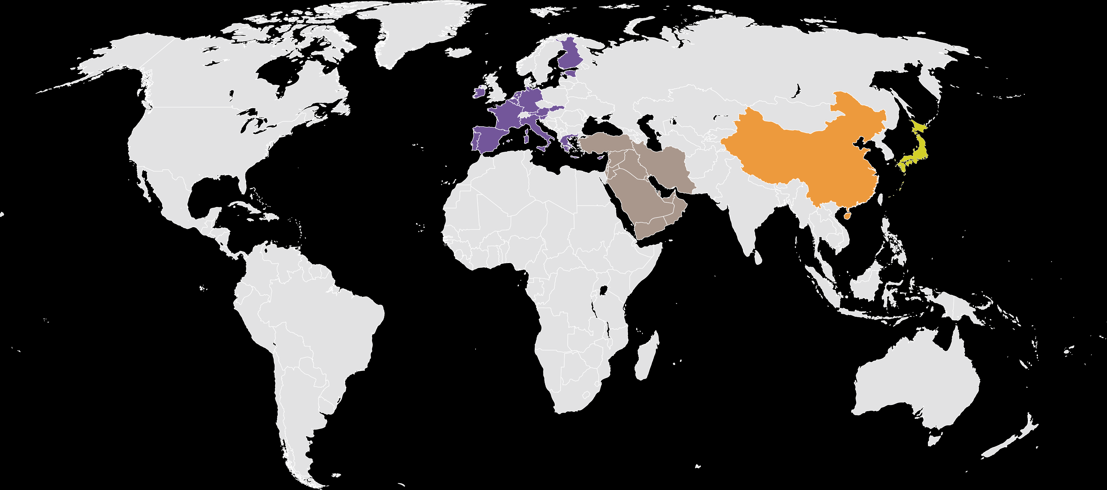
When is a good time to invest internationally — and where?
Eurozone?
Japan?
China?
The Middle East?
Notes:
Meanwhile, unrest in the Middle East threatens the region and global oil supplies…

Slide 20
Recent index performance
Returns in USD
As of September 30, 2012 (%)
Notes:
Let’s look briefly at recent returns for these markets.
Emerging markets investors were rewarded handsomely in 2010 – but gave up nearly all those returns in 2011, then bounced back some in 2012.
Developed international markets offered meager returns in 2010 – and then lost all those gains and then some, in 2011, but rose in 2012.
The US stock market enjoyed double digit returns in 2010 – squeaked by in 2011 – and outperformed the other regions in 2012.

Slide 21
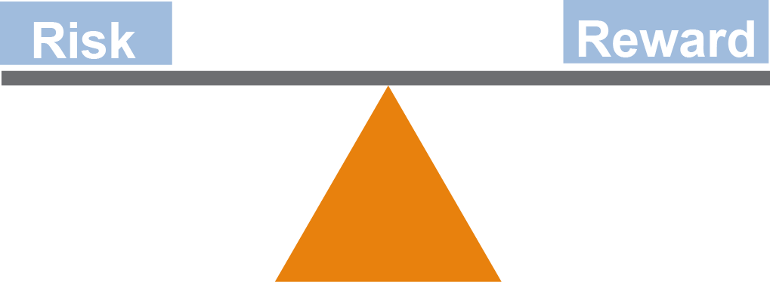
Balancing global risks
Notes:
The fact is, international investing typically offers a higher risk/reward profile than domestic investing.
While exposure to international markets can reduce overall portfolio risk and dampen volatility through diversification and lower correlations — there are risks.
Revolution in the Middle East, a devastating earthquake in Japan or New Zealand, and debt crises in Greece, Portugal, Italy and Spain can all have profound effects on the prices of international companies.
Fluctuations in currencies can also impact investment returns — both positively and negatively.
Political and operational risks are also important factors to consider when investing in international markets.

Slide 22
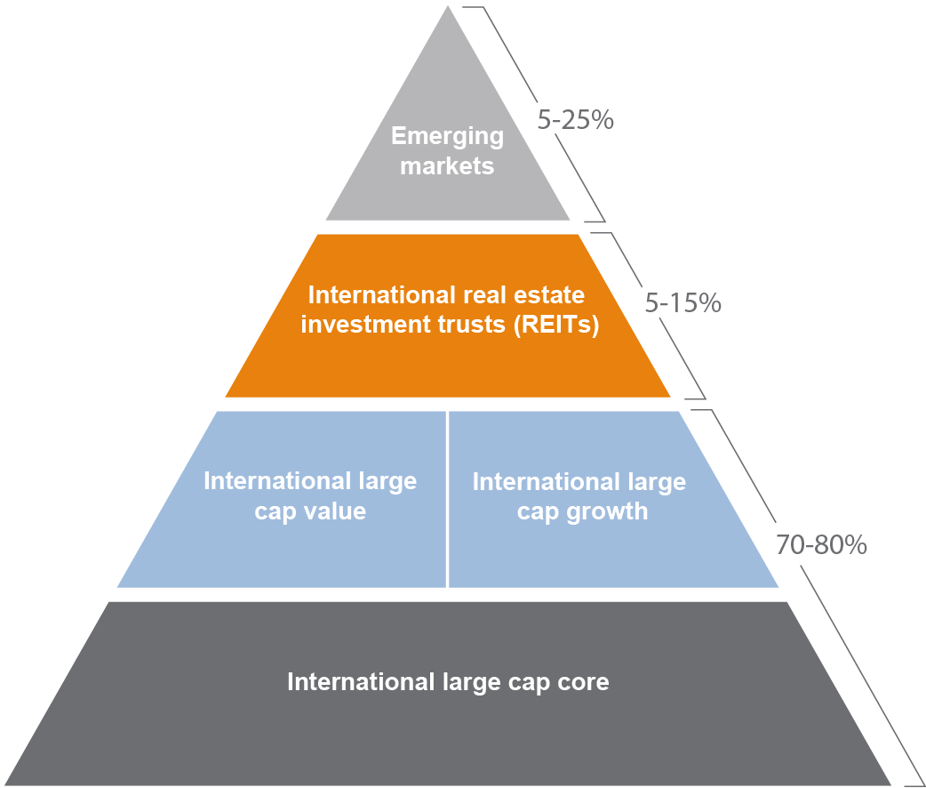
Investors need to be better diversified
Take a more diversified approach to international investing
PROBLEM
In many portfolios, international stocks are less diversified than U.S. stocks — even though foreign markets offer a world of investment choices.
RESULT
Missed opportunities to participate in global economic growth, increase long-term return potential and diversify outside the United States.
SOLUTION
Invest more strategically across a broader mix of countries (developed and emerging), styles (core, growth, value) and industries (including real estate).
Notes:
We believe that investors need to take a disciplined, diversified approach to international markets – an approach that is illustrated here by our international investment pyramid.
International equity portfolios especially are often less diversified than U.S.-only portfolios — despite the world of investment choices — and often because foreign investment research is so time and resource intensive.
Too often the result is a missed opportunity to participate in global economic growth, increased long-term return potential and diversify holdings beyond the U.S.
At J.P. Morgan, we recommend that investors invest more strategically across a broader mix of developed and emerging countries, styles — including core, growth and value — and across various industries, including real estate.

Slide 23
Diversification matters
Notes:
We believe that to achieve meaningful diversification, investors should incorporate developed and emerging markets equity, fixed income and currency exposure to their overall long-term portfolios.
This multi-colored chart demonstrates that because asset classes don’t move in lockstep, being appropriately diversified across a broader opportunity set can help reduce volatility and increase long-term returns. Here we’ve tracked the performance of the “asset allocation” portfolio in this chart. This hypothetical portfolio offers significant exposure to international opportunities and would have returned 74% over the past 10 years, while the S&P 500 returned only 33% over the same period.
American investors are exposed to some foreign markets by virtue of the fact that so many U.S. companies generate profits from overseas. Yet research suggests that the average investor remains underweight international equities, despite marked improvement over the last decade.
Furthermore, our analysis shows that owning emerging market equities and emerging market debt as part of a balanced portfolio has the potential to bolster portfolio returns as well as to provide diversification benefits over the long term.

Slide 24

Summary
The world has changed
Emerging markets are playing a larger role on the global stage
Opportunities exist worldwide — but investors must be mindful of the risks as well
Active risk management and greater diversification are essential for American investors seeking to venture beyond U.S. shores
Notes:
We’ve covered a lot of territory today. Let me try to summarize the most important points.
We reviewed the definitions for domestic, global and international investing, and the differences between developed and developing markets.
We also established the fact that today’s global financial markets are shifting, in part due to the demographics and the growth of emerging markets, like China, Brazil and India. These economies are becoming less dependent on developed market consumption to fuel their growth.
To be sure, opportunities exist worldwide — but investors must be mindful of the political, legal, currency and market risks. Specifically in emerging markets, there are many more variables to consider than in developed markets. Factors, such as political risk, macro-economic uncertainty and currency volatility, have a major influence on the overall investment climate. Regulations and corporate governance, although improving in general, are not always as transparent as in developed countries.
Active risk management can provide an added layer of protection to limit portfolio losses caused by short-term volatility spikes and prolonged market downturns.
A well-diversified asset allocation program that combines a strategic selection of assets, and the ability to make more frequent, tactical allocation decisions based on the economic climate, can provide the framework for successful, long-term investment in today’s global financial markets.

Slide 25
Thank you
Notes:
Thank you for the opportunity to share our views on international investing today. It’s a vast, global marketplace that’s constantly shifting and an exciting time to be an investor.

Slide 26
J.P. Morgan Asset Management
The above commentary is intended solely to report on various investment views held by J.P. Morgan Asset Management. Opinions and estimates offered constitute our judgment and are subject to change without notice, as are statements of financial market trends, which are based on current market conditions. We believe the information provided here is reliable, but do not warrant its accuracy or completeness. This material is not intended as an offer or solicitation for the purchase or sale of any financial instrument. The views and strategies described may not be suitable for all investors. This material has been prepared for informational purposes only and is not intended to provide, and should not be relied on for, accounting, legal or tax advice. References to future returns are not promises or even estimates of actual returns a client portfolio may achieve. Any forecasts contained herein are for illustrative purposes only and are not to be relied upon as advice or interpreted as a recommendation.
J.P. Morgan Asset Management is the marketing name for the asset management businesses of JPMorgan Chase & Co. Those businesses include, but are not limited to, J.P. Morgan Investment Management Inc., Security Capital Research & Management Incorporated and J.P. Morgan Alternative Asset Management, Inc.
© J.P. Morgan Chase & Co., March 2013

Slide 27
声明：
所有的版权属于原有公司，文件均来自公开渠道
此文件仅供学习使用，任何人不得进行以此为商业目的的行为
如有疑问，请立即删除
学习世界五百强和咨询公司PPT课程请访问如下网站搜索：“司马懿”
百度传课：司马懿PPT学校
https://www.chuanke.com
网易学堂：司马懿PPT学校
https://study.163.com
知乎： 司马懿PPT学校
https://www.zhiu.com

